Slide 1
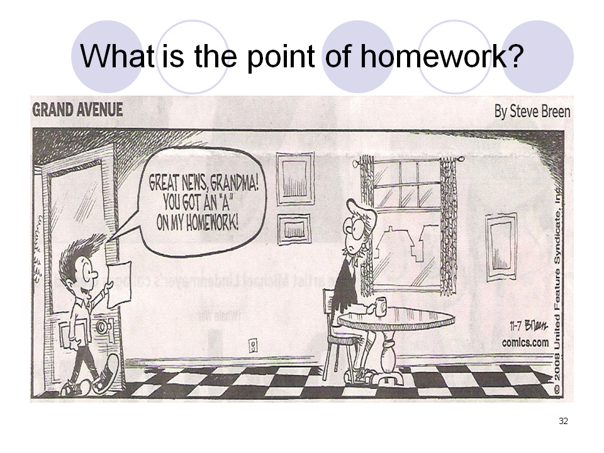
GRADING PRACTICES
A Clearer, Shorter, More Meaningful Case for Grading Reform
Rebuilt from the original 2008-2009 FLMS presentation and reframed around best-practice grading research.
5
4
10
research anchors
grading commitments
presentation slides
Built from source slide images in this workspace; redesign emphasizes current achievement, equity, and learning-focused reporting.

Slide 2
PURPOSE
What Good Grades Are Supposed to Do
A grade should clarify learning, not obscure it.
Communicate
Guide action
Stay fair
Protect motivation
Tell students and families what has been learned right now.
Point to the next instructional or support move.
Reduce teacher-to-teacher inconsistency and hidden penalties.
Encourage persistence instead of signaling that recovery is impossible.
The problem with many legacy systems
They mix academic achievement with compliance, effort, and behavior.
They average learning over time instead of reflecting the student's current level.
They allow one missing task or one major assignment to dominate the term grade.
A useful test
If two teachers looked at the same body of evidence, would they likely assign the same grade for the same reason? If not, the system needs repair.
Research frame: Brookhart, Guskey, McTighe, & Wiliam (2020), ASCD Educational Leadership.

Slide 3
RESEARCH
Research Consensus in One Slide
The strongest recurring ideas are surprisingly consistent across major grading scholars.
1. Grade clear learning outcomes
2. Reflect current achievement
3. Separate achievement from behavior
Grades should be anchored to intended learning, not a pile of disconnected tasks.
The most recent and most consistent evidence matters more than early struggles.
Homework completion, attendance, effort, and punctuality should be reported separately.
4. Use fewer gradations
5. Design for equity
Fewer score bands improve consistency and reduce false precision.
Assessments should allow students to show learning without irrelevant cultural or linguistic barriers.
Ken O'Connor's shorthand is useful here: grades should be CALM - consistent, accurate, learning-focused, and meaningful.
Sources: O'Connor Grading website (2022 site text citing How to Grade for Learning, 4th ed., 2018); Brookhart et al. (2020); Chism & Brookhart (ASCD, May 1, 2025).

Slide 4
DECISIONS
Stop Doing This. Start Doing This Instead.
A short deck should make the decisions easier, not more abstract.
STOP
START
Averaging everything by default
Treating missing work as zero understanding
Using one 'killer' assignment to decide a term grade
Burying behavior and effort inside academic grades
Listing tasks instead of standards in the gradebook
Prioritizing current and consistent evidence
Using incomplete plus required completion/reassessment
Allowing multiple opportunities to show mastery
Reporting work habits separately
Organizing grades by learning targets and concepts
Synthesis of Brookhart et al. (2020), Guskey (2011 summary), and the original FLMS presentation themes.

Slide 5
EVIDENCE
Why Averaging Misrepresents Learning
A grade can be mathematically tidy and still educationally misleading.
75
92
simple average
current evidence
88
92
76
64
What the grade should say
55
If the student now demonstrates proficiency, the report should communicate that current level, while earlier attempts remain useful for feedback and instruction.
Attempt 1
Attempt 2
Attempt 3
Attempt 4
Current
Brookhart et al. (2020): grades should reflect current achievement, not an average over the marking period.

Slide 6
PRACTICE
Missing Work Is a Workflow Problem, Not a Zero
The consequence should trigger action, not grade collapse.
1
2
3
4
Mark as incomplete
Diagnose why
Re-teach or support
Reassess and update
Accountability remains: students still complete the work or comparable evidence.
Teachers gain cleaner information about what was missing: learning, time, support, or access.
Students are less likely to interpret one mistake as permanent failure.
Guskey obstacle summary (2011 article summary): low grades are not motivational; an incomplete with required support is more effective.

Slide 7
CLARITY
Separate Academic Achievement from Learning Behaviors
Otherwise the grade tells families several things at once and none of them clearly.
Belongs in the academic grade
Report separately
Mastery of standards
Quality of reasoning
Accuracy of final performance
Transfer and application of learning
Homework completion
Participation
Effort
Attendance
Behavior / punctuality
Collaboration habits
Separate reporting improves fairness and makes intervention more precise: academic support for learning gaps, behavior support for habit gaps.
Brookhart et al. (2020), lines 91-93 on ASCD: achievement should be reported separately from homework, behavior, attendance, and related factors.

Slide 8
EQUITY
Fairer Grading Also Means More Equitable Grading
A grade should capture learning, not hidden advantage.
Ask before scoring
Watch for bias
Design response
Can students relate to the context?
Did we teach the language the task requires?
Are there multiple valid ways to demonstrate the learning target?
Neatness, style, accent, compliance, and speed often get rewarded even when they are not the intended learning outcome.
Use culturally relevant contexts, accessible language, and assessment options that let students show what they know.
Chism & Brookhart, 'Three Principles for Fairer, More Relevant Grading,' ASCD, May 1, 2025.

Slide 9
SYSTEMS
Redesign the Gradebook Around Standards, Not Tasks
This is where grading reform becomes visible to teachers, students, and families.
Traditional entries
Learning-centered entries
4
Page 87
Homework 3
Quiz 2
Participation
Project
Late penalty
Citing textual evidence
Solving linear equations
Analyzing lab results
Argument structure
Revision based on feedback
Exceeds / sophisticated
3
Meets standard
2
Approaching
1
Beginning
Brookhart et al. (2020): fewer gradations improve reliability; original FLMS slides also argued for concepts in the gradebook rather than assignments.

Slide 10
ACTION
A Practical 90-Day Grading Reform Plan
Keep the change narrow enough to implement well.
Days 1-30: Audit
Days 31-60: Pilot
Days 61-90: Communicate
Identify where grades currently mix achievement with behavior.
Find courses using zeros, averaging, and heavy late penalties.
Select 3-5 pilot learning targets.
Use a common proficiency scale.
Replace zeros with incomplete plus completion plans.
Reassess selected standards and update grades based on current evidence.
Show families sample before-and-after gradebook entries.
Calibrate teacher judgments with shared student work.
Decide what will be reported separately from achievement.
Best practice inference from the cited research: start with reporting clarity, a small pilot, and teacher calibration before scaling.

Slide 11
CLOSE
Bottom Line
Better grading is not easier grading. It is more accurate grading.
Base grades on clear learning outcomes and high-quality evidence.
Prioritize current achievement over the arithmetic average of all attempts.
Report achievement separately from behavior, effort, and homework habits.
Use incomplete and reassessment workflows instead of punitive zeros.
Key sources used in this revision
Brookhart, Guskey, McTighe, & Wiliam. Eight Essential Principles for Improving Grading. ASCD, 2020.
O'Connor Grading website summary of CALM and grading guidelines.
Guskey, obstacle summary of grading reform (2011 article summary).
Chism & Brookhart. Three Principles for Fairer, More Relevant Grading. ASCD, May 1, 2025.
If you want, I can next turn this into a district PD version, a faculty meeting version, or a principal one-pager.
Deck output: grading_practices_best_practices_short.pptx

